Slide 1
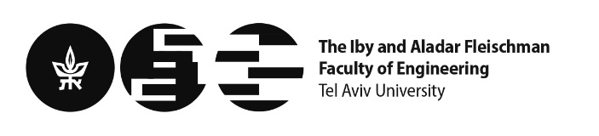
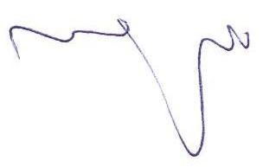
DCO Project
Project Name: Digital high-frequency source on a chip - digitally controlled oscillator
Project Number: 22-1-12723
Students: Alisa Gumerova I.D. 956711378, Maya Shami I.D. 209369347
Project Mentor: Prof. Eran Socher
Project Location: VLSI Lab, Tel Aviv University
Mentor’s Signature:
_______________

Slide 2
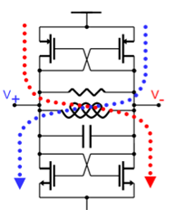
Project Topic
DPLL project, focusing on a DCO
DCO
LC tank (inductor + capacitor bank - controlled by switches) + Amplifier
non-linear circuit
converts DC power into a periodic electrical waveform
harmonic oscillator
our goal: designing and building a DCO from scratch

Slide 3
DCO Specifications
Characteristic | Description | Target
V_{DD} | Nominal operating voltage | 0.8 V
f_{top} | Upper oscillation frequency | 10.5 GHz
f_{bottom} | Bottom oscillation frequency | 9.5 GHz
mtrx_{n} | Digital varactor capacitors | 256
df_{mtrx} | Digital varactor resolution | 1.1 MHz
Is | Operational current | < 3mA
pn_100K | Phase noise at 100 kHz offset | -77 dBc/Hz
pn_1M | Phase noise at 1 MHz offset | -100 dBc/Hz
pn_10M | Phase noise at 10 MHz offset | -120 dBc/Hz

Slide 4
Our Workflow
Theoretical calculations based on the project specifications
Schematic-level design
Simulations
Layout
Extraction
Simulations and verification

Slide 5
DPLL: Block Diagram

Slide 6
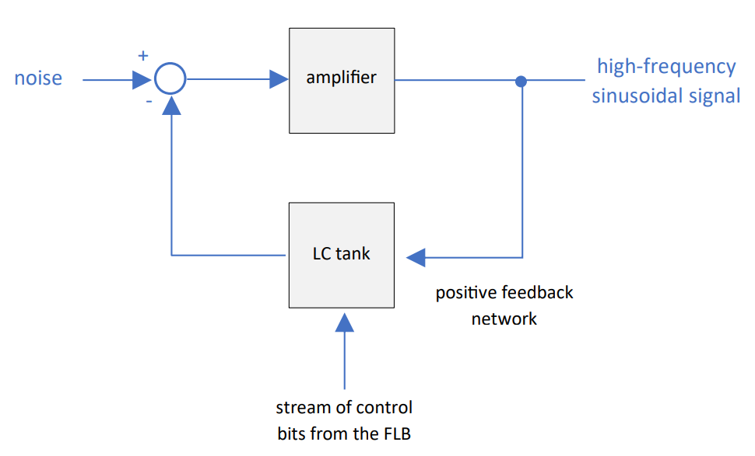
DCO: Block Diagram
All blocks are implemented by us
Using Virtuoso
LC tank
Inductor
Capacitor bank: coarse
& fine-tuning unit cell
Capacitor matrix: very fine tunning
Differential amplifier

Slide 7
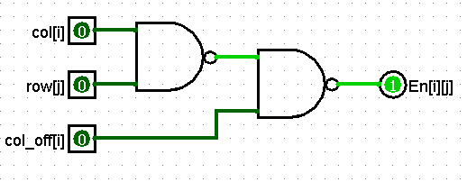
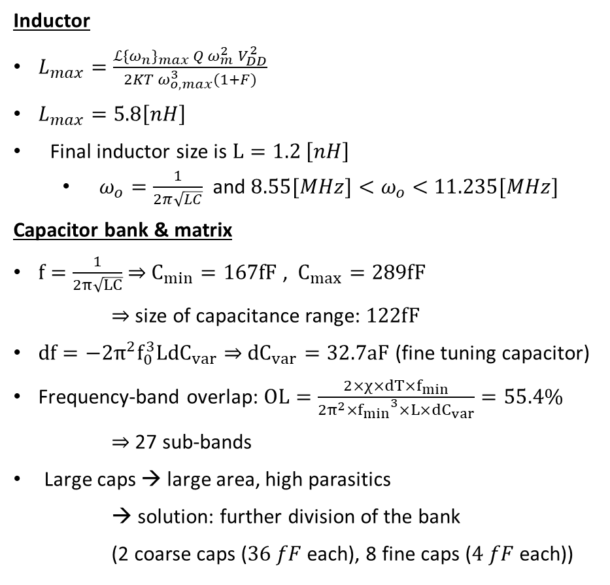
Calculations
Inductor
$L_{max}=\frac{ℒ{\{ω_{n}\}}_{max} Q{ ω}_{m}^{2}{ V}_{DD}^{2}}{2KT{ ω}_{o, max}^{3}(1+F)}$
$L_{max}=5.8\left[nH\right]$
Final inductor size is $L=1.2 \left[nH\right]$
$ω_{o}=\frac{1}{2π\sqrt{LC}}$ and ${8.55[MHz]<ω}_{o}<$ $11.235[MHz]$
Capacitor bank & matrix
$f=\frac{1}{2π\sqrt{LC}}$⇒ $C_{min}=167fF$ , $C_{max}=289fF$
⇒ size of capacitance range: $122fF$
$df=−2π^{2}f_{0}^{3}L{dC}_{var}$ ⇒ ${dC}_{var}=32.7aF$ (fine tuning capacitor)
Frequency-band overlap: $OL=\frac{2×χ×dT×f_{min}}{2π^{2}×{f_{min}}^{3}×L×dC_{var}}=55.4\%$
⇒ 27 sub-bands
Large caps → large area, high parasitics
→ solution: further division of the bank
(2 coarse caps ($36 fF$each), 8 fine caps ($4 fF$ each))
Capacitor matrix – logic:
En = ~col_off + col · row = ~ (col_off · (~ (col · row))
col[i] | row[j] | col_off[i] | En[i][j]
0 | 0 | 0 | 1
0 | 0 | 1 | 0
0 | 1 | 0 | 1
0 | 1 | 1 | 0
1 | 0 | 0 | 1
1 | 0 | 1 | 0
1 | 1 | 0 | 1
1 | 1 | 1 | 1

Slide 8
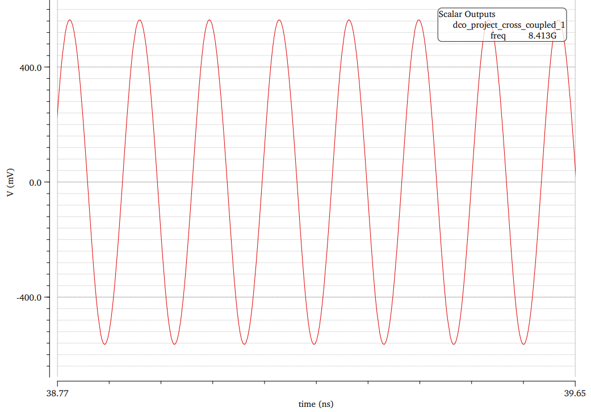
Simulations
Cross-coupled oscillator
Non-ideal components chosen from analoglib
Goal: lower oscillation frequency of 8.55 GHz , upper oscillation frequency of 11.235 GHz (10% below and 7% above the spec)
Result: 8.4 GHz, 11 GHz

Slide 9
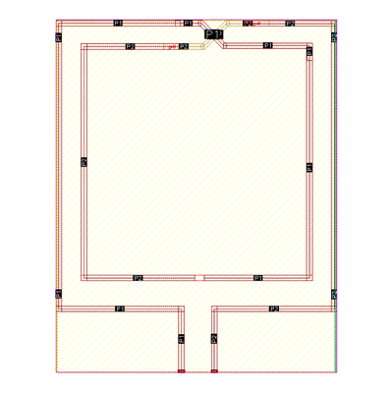
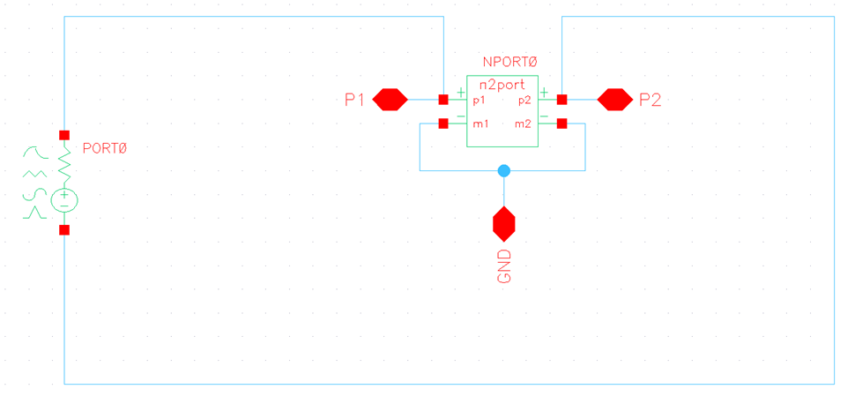

Inductor – Implementation
$L_{max}=5.8\left[nH\right]$
Final inductor size is $L=1.2 \left[nH\right]$
Layout of 1.2nH inductor
Schematic of the inductor for SP simulation

Slide 10
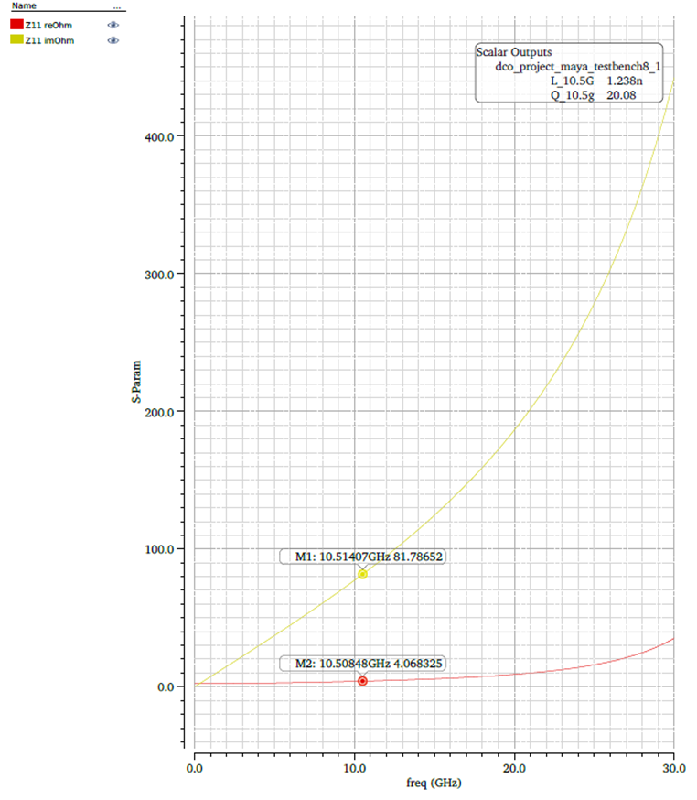
Inductor – Simulation Results
S-parameter simulation and calculation of the inductance and the Q

Slide 11
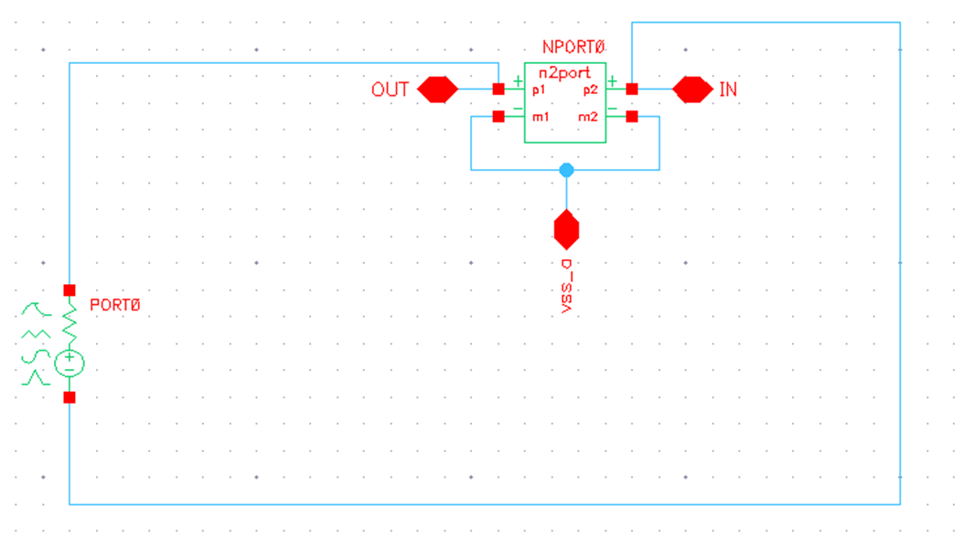
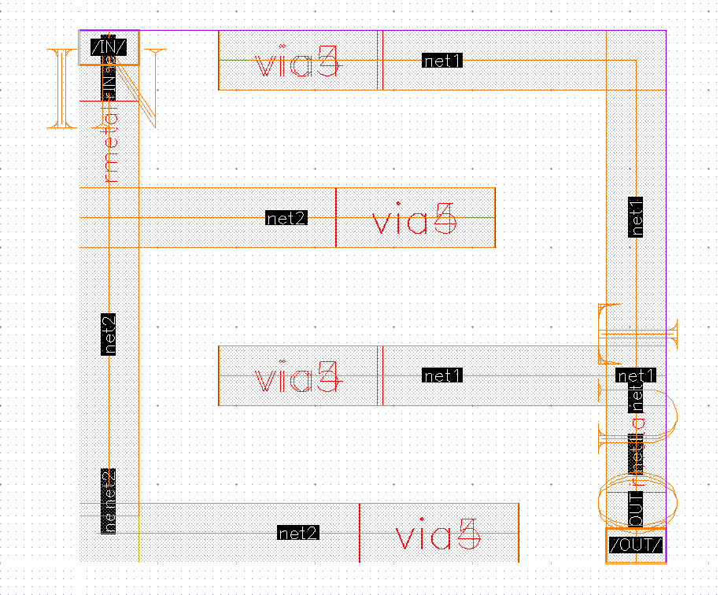

Capacitor Matrix – Single Cap
Built in Hierarchal manner: Single capacitor Single cell Single cell with logic 4-cells with logic The matrix (256 cells)
A single capacitor
Layout of $\sim 250aF$capacitor.
Schematic of a single capacitor for SP simulation

Slide 12
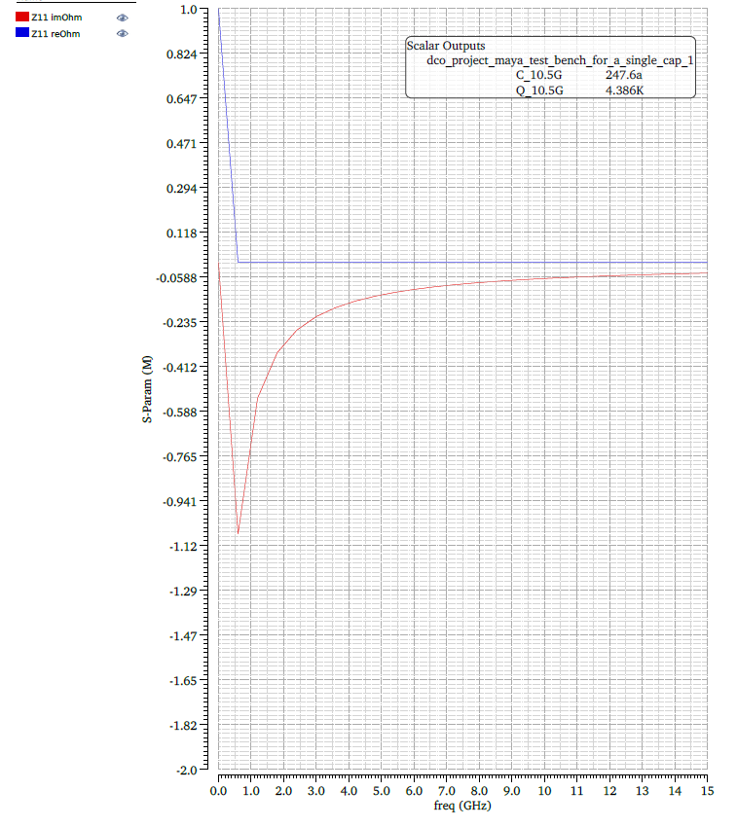
Capacitor Matrix – Single Cap
S-parameter simulation and extraction of the capacitor size and the Q

Slide 13
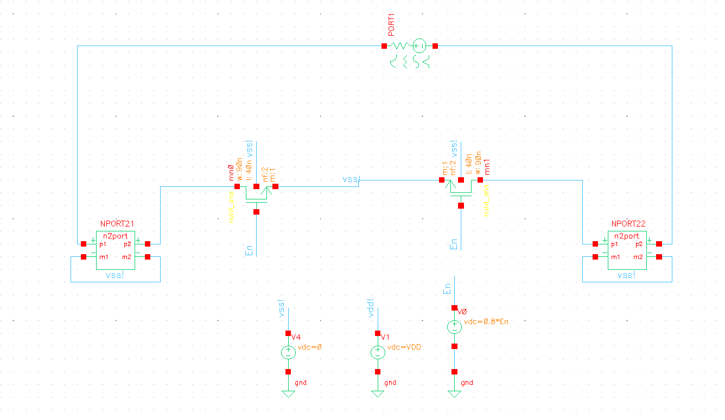
Capacitor Matrix – Single Cell
Schematic of A single cell for the simulation of $∆C$

Slide 14
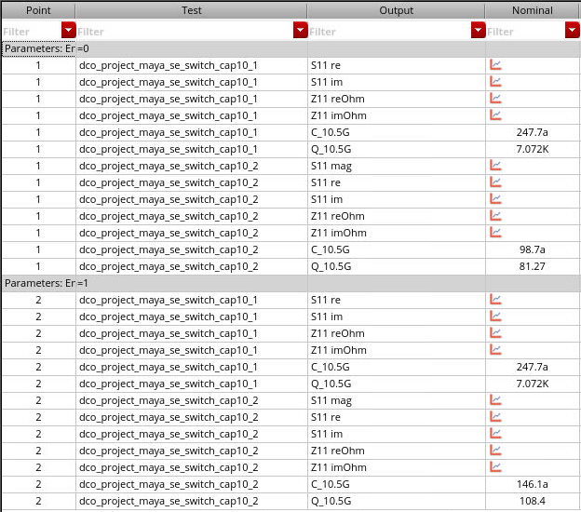
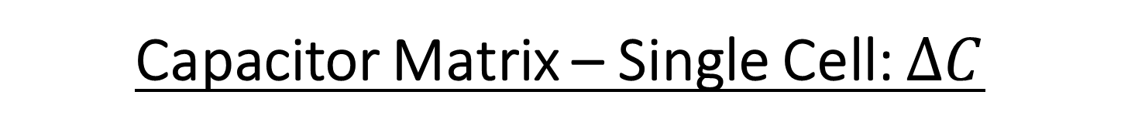
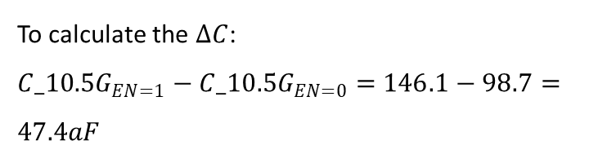
Capacitor Matrix – Single Cell: $∆C$
To calculate the $∆C$: ${C_10.5G}_{EN=1}−{C_10.5G}_{EN=0}=$ $146.1−98.7=47.4aF$
Simulation’s results for Enable = 0 & Enable = 1.

Slide 15
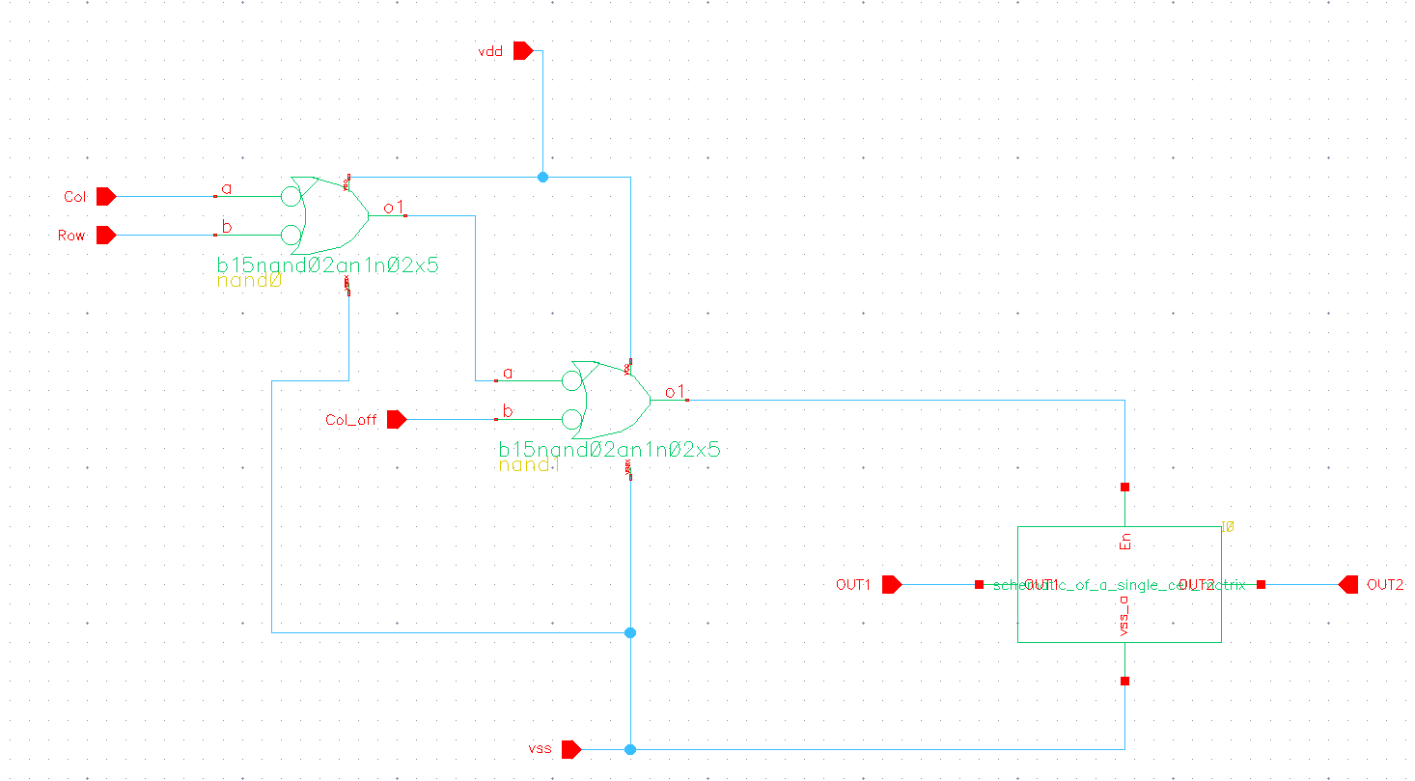
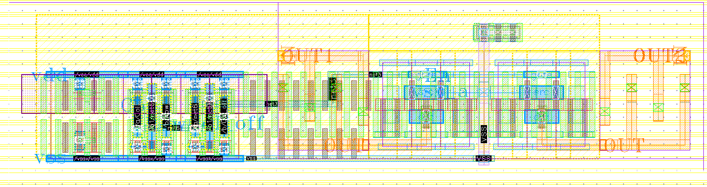
Capacitor Matrix – Cell
A single cell with logic
The logic: En = ~col_off + col · row = ~ (col_off · (~ (col · row))
Schematic and Layout of a single cell with logic.

Slide 16
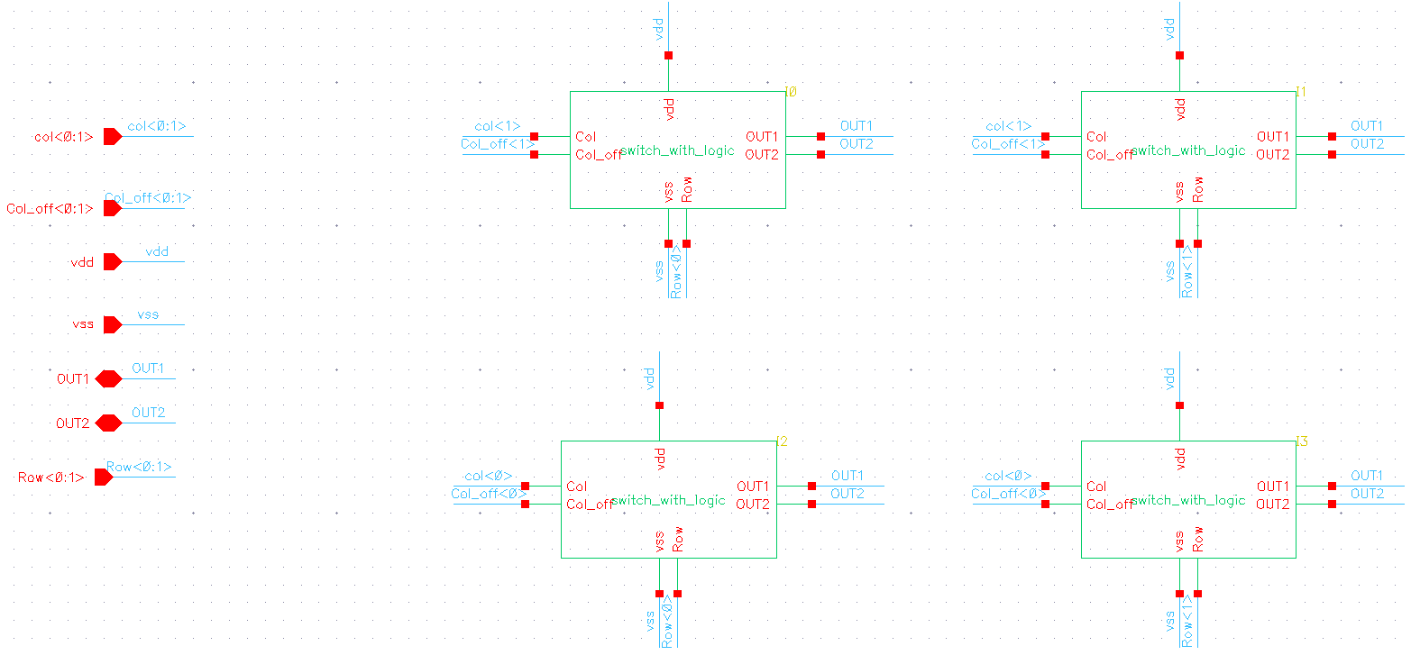
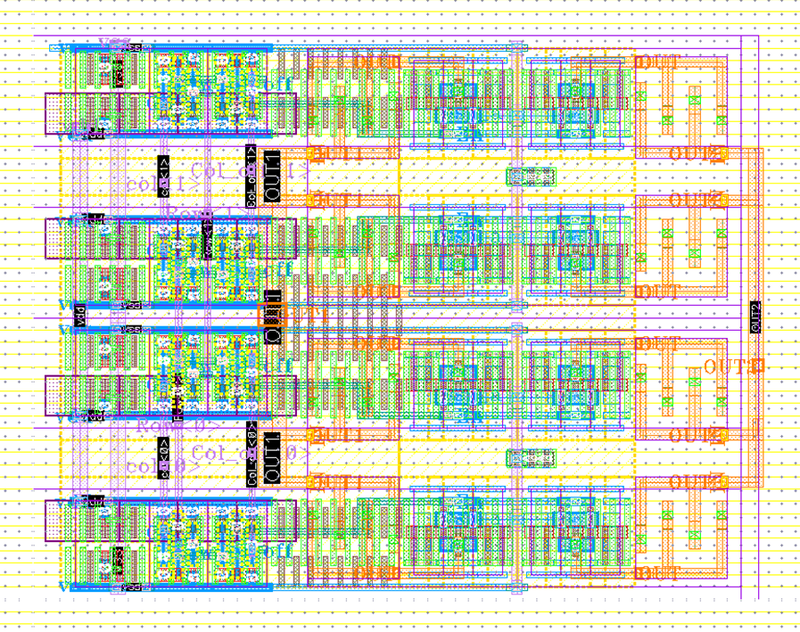
Capacitor Matrix – 4 Cells
4-cells block - an intermediate step to ease the layout process of the whole matrix
Schematic and Layout of 4-cells block.

Slide 17
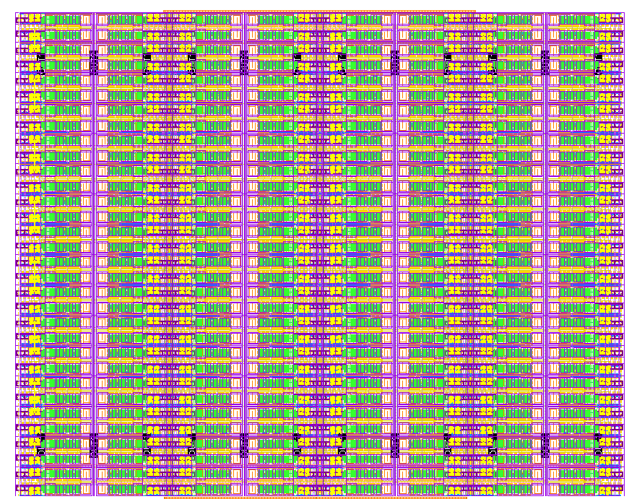
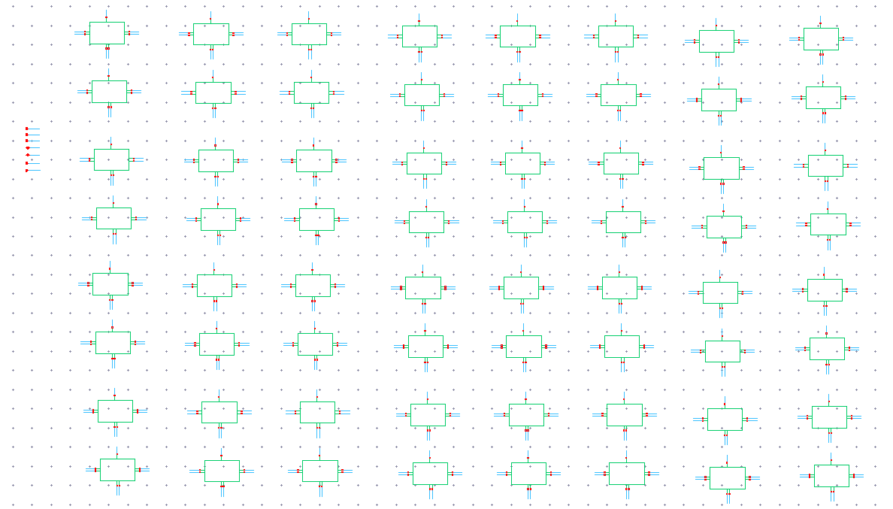
Capacitor Matrix – Whole
The whole matrix
Schematic and Layout of the whole matrix

Slide 18
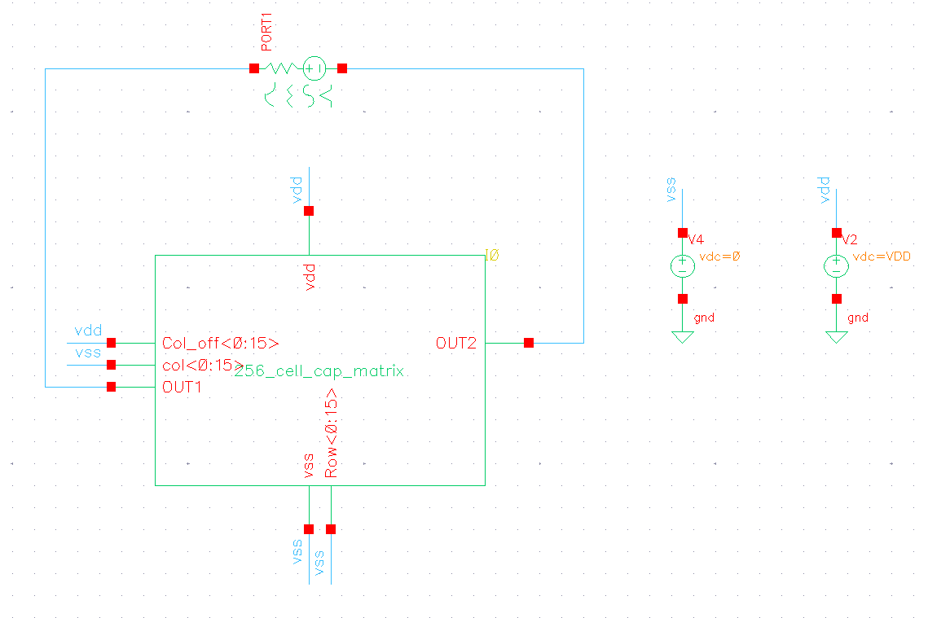


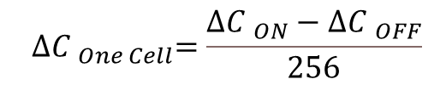
Capacitor Matrix – Simulations & Results
Results of ON and OFF modes of the matrix
$${∆C }_{One Cell}=\frac{{∆C }_{ON}−{∆C }_{OFF}}{256}$$
$${∆C }_{One Cell}=\frac{51.71×{10}^{−15}−41.29×{10}^{−15}}{256}=40.07×{10}^{−18}=40.07aF$$
Schematic of simulation for $∆C$ calculation
OFF Mode: col<0:15> & Row<0:15> -VSS, Col_off<0:15> -VDD
ON Mode: col<0:15> & Row<0:15> -VDD, Col_off<0:15> VSS

Slide 19
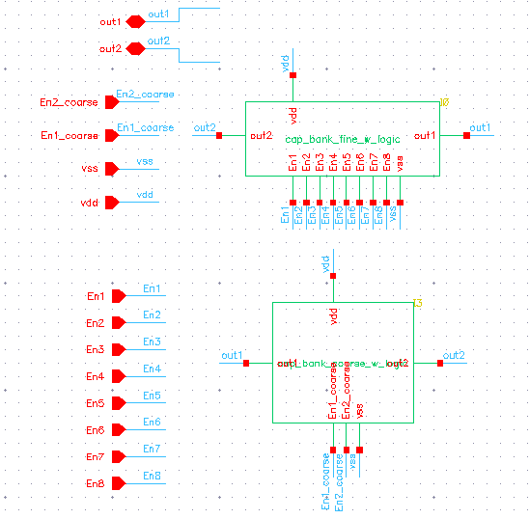
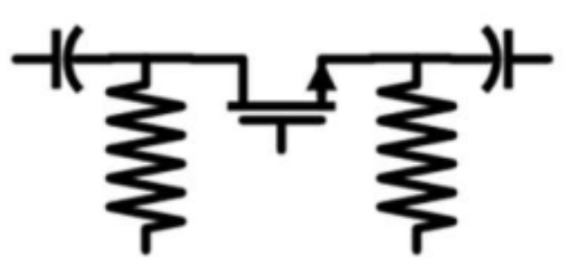
Capacitor Bank
2 sub-blocks: coarse (2 cells, 36fF each), fine (8 cells, 4fF each)
Both use differential switches
Transistor (switch)
2 biasing resistors (+ invertor)

Slide 20

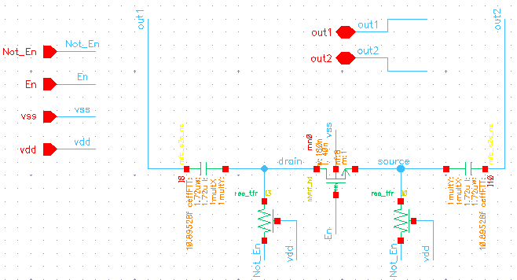
Capacitor Bank - Fine-Tuning: Cell
Goal: ΔC = 4fF + spare
Before extraction: ΔC = 5.03fF
After extraction: ΔC = 4.77fF

Slide 21
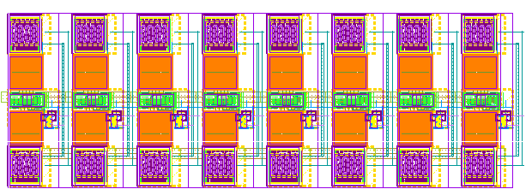
Capacitor Bank - Fine-Tuning: Block
8 cells in parallel – connections through a high metal

Slide 22
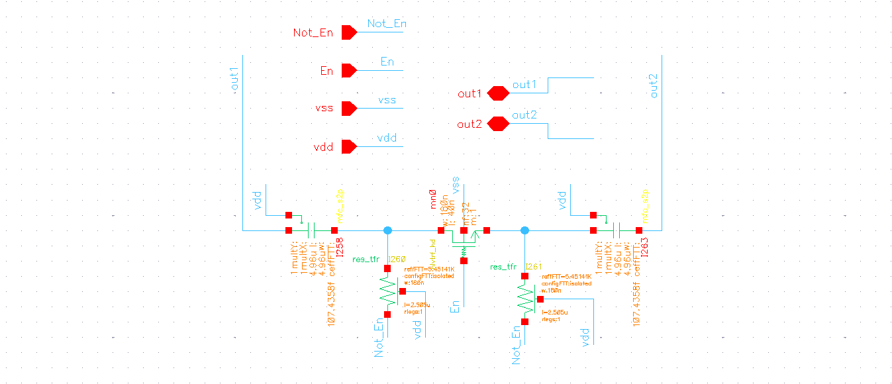
Capacitor Bank - Coarse-Tuning: Cell
Identical to fine-tuning, except:
Larger capacitors
Larger transistors – 2 in parallel to achieve a wider effective gate
Goal: ΔC = 36fF + spare
Before extraction: ΔC = 40.4fF
After extraction: ΔC = 38.27fF

Slide 23
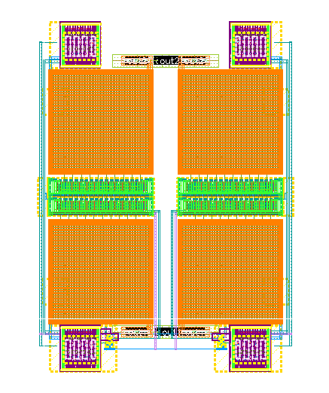
Capacitor Bank - Coarse-Tuning: Block
2 cells in parallel – connections through a high metal

Slide 24
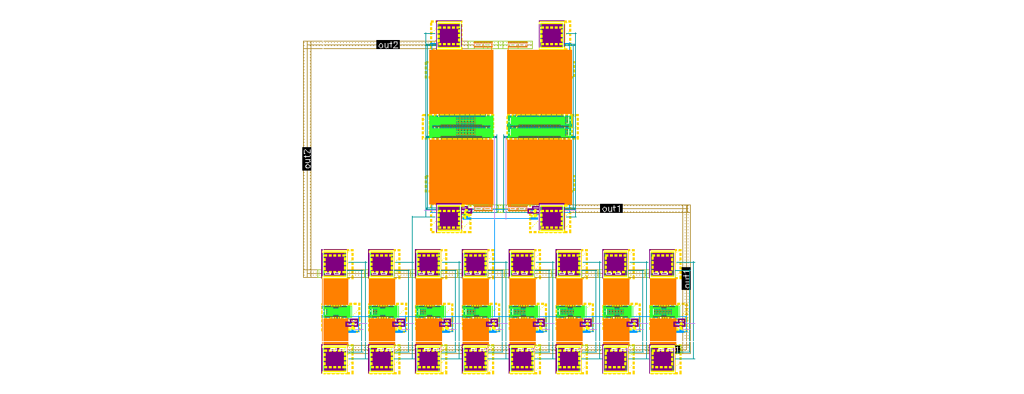
Capacitor Bank – Full Layout

Slide 25
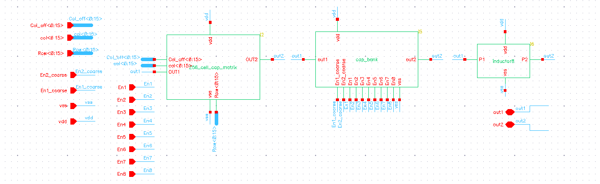
LC Tank

Slide 26
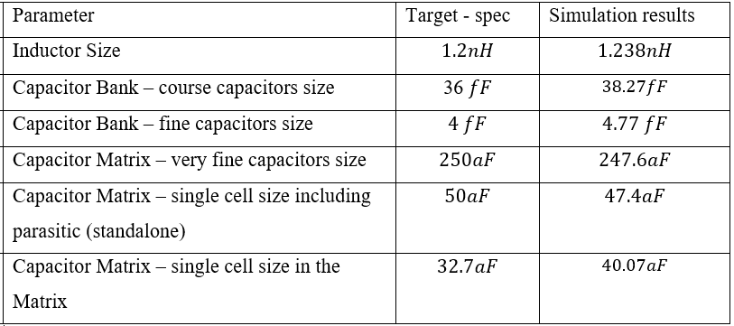
LC Tank - Summary of Results

Slide 27
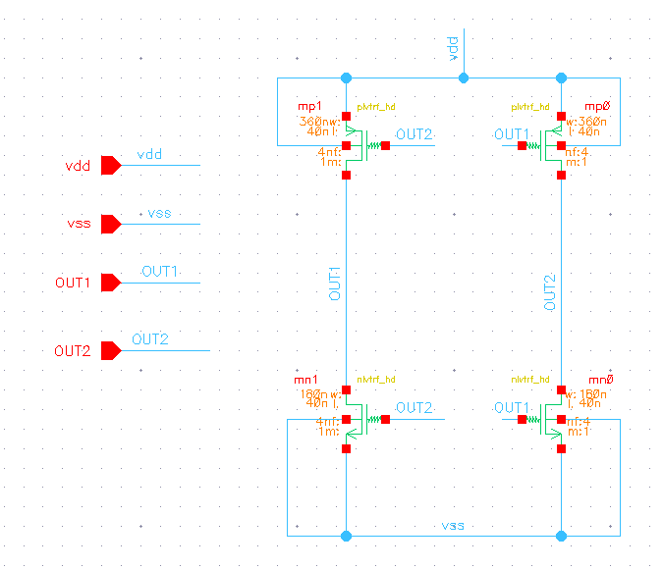
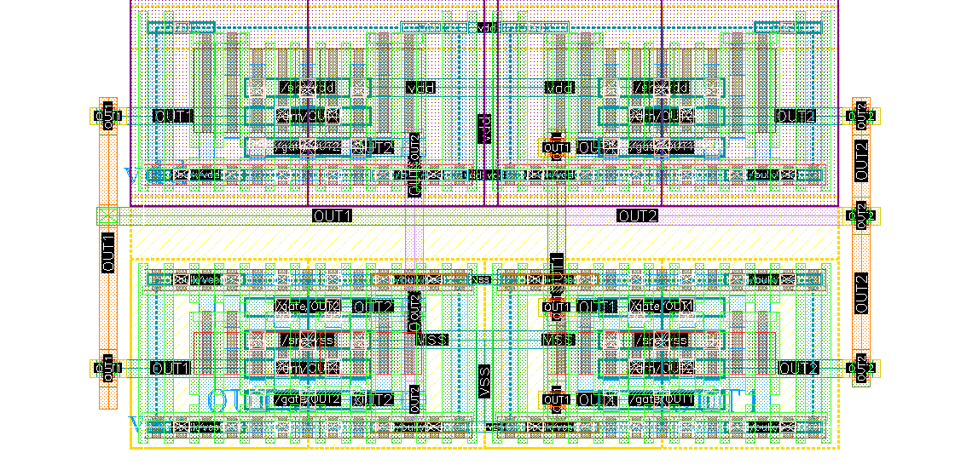
Amplifier

Slide 28
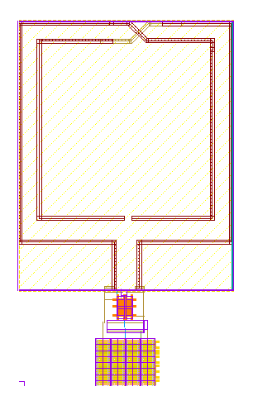
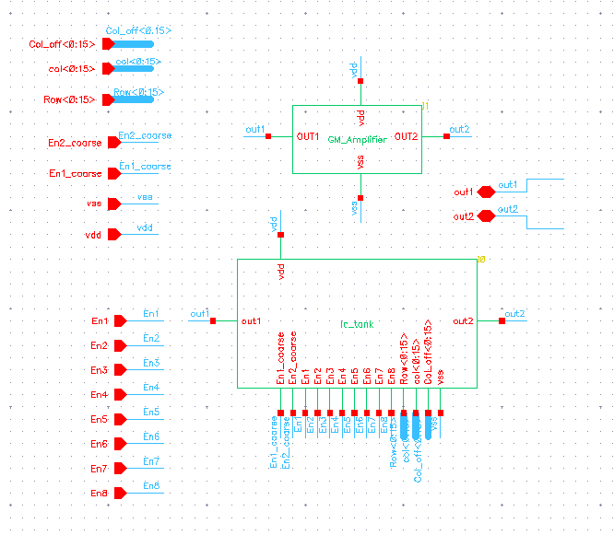
DCO

Slide 29
Challenges and the Solutions

Slide 30
Final simulations & results
 | Parameter | Target - spec | Simulation results
 | Is - Operational current | < 3mA | ON – 2.367 mA OFF – 2.194 mA
 | f_bot - Bottom oscillation frequency | 9.5 GHz (with spare 8.55GHz) | 8.98 GHz
 | f_top - Upper oscillation frequency | 10.5 GHz (with spare 11.235 GHz) | 12.34 GHz
 | mtrx_n - Digital varactor capacitors | 256 | 256
 | df_mtrx – Minimal jump in tuning range | < 1.2 MHz | 1.1 MHz
 | Pn_100K – Phase noise at 100kHz offset | -77 dBc/Hz | ON – -72.547 dBc/Hz OFF – -64.955 dBc/Hz
 | Pn_1M – Phase noise at 1 MHz offset | -100 dBc/Hz | ON – -100.130 dBc/Hz OFF – -93.412 dBc/Hz
 | Pn_10M – Phase noise at 10 MHz offset | -120 dBc/Hz | ON – -122.913 dBc/Hz OFF – -117.403 dBc/Hz

Slide 31
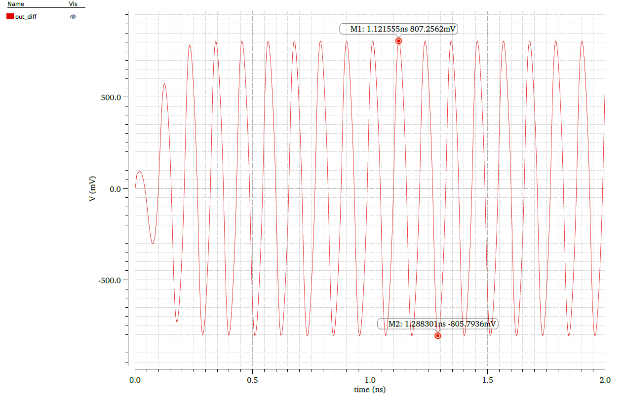
Final simulations – Transient (ON state)

Slide 32
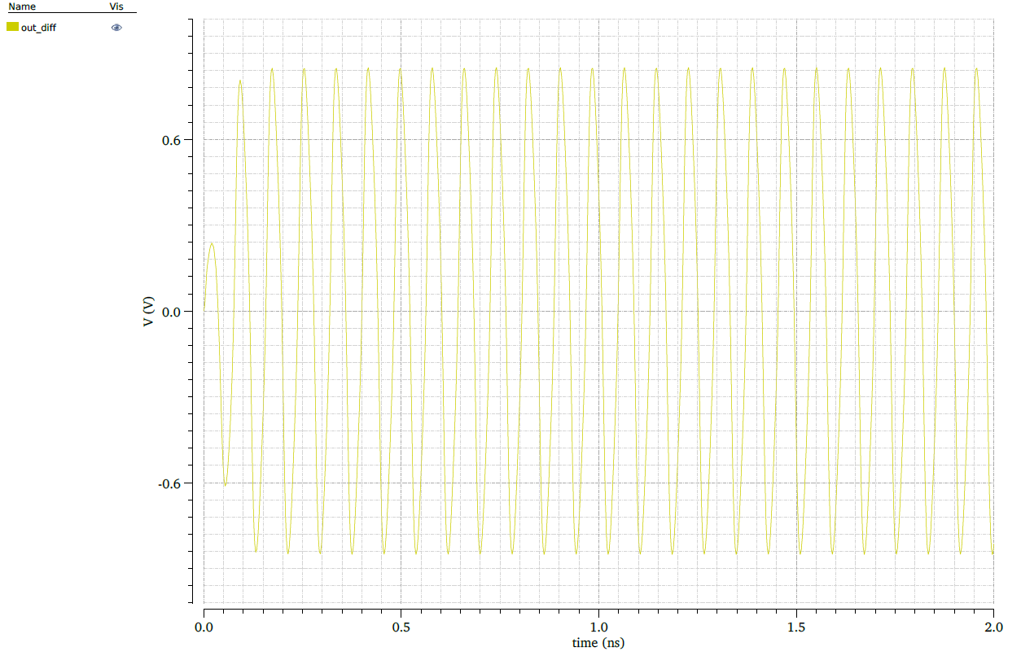
Final simulations – Transient (OFF state)

Slide 33
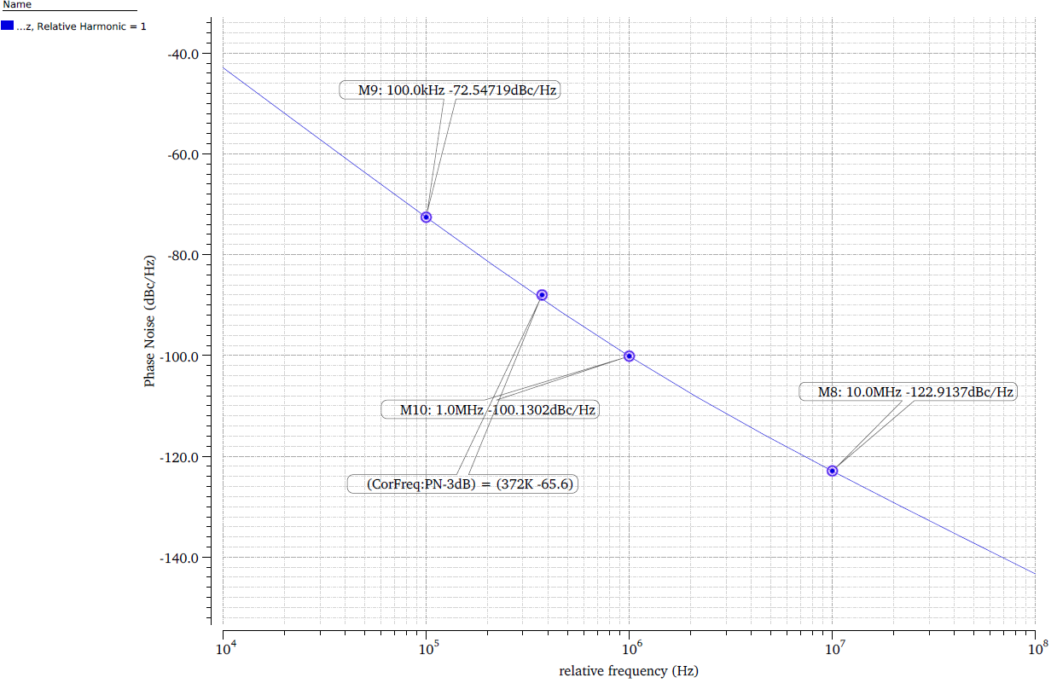
Final simulations – hbnoise (ON state)

Slide 34
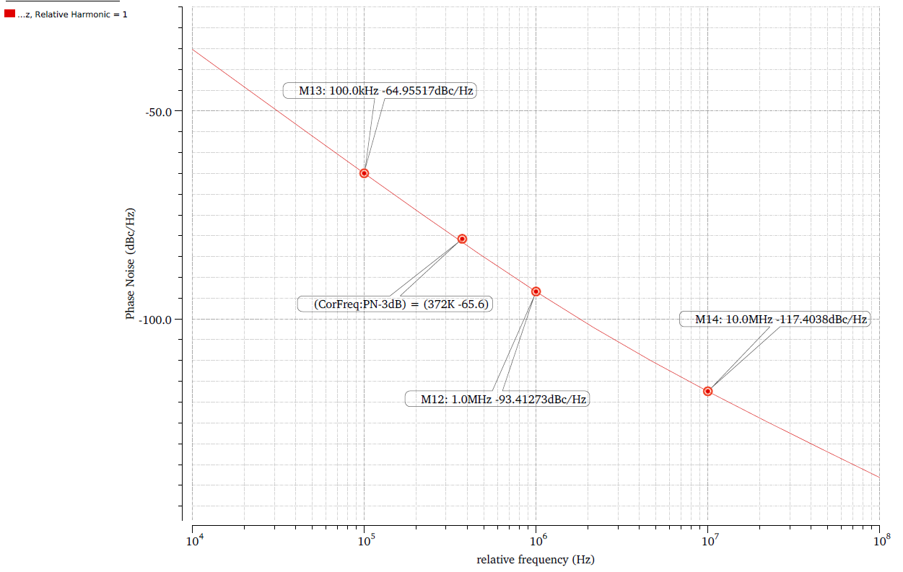
Final simulations – hbnoise (OFF state)

Slide 35
Conclusions & Future work
Increasing the amplifier gain
Lowering area – more loops in the inductor, improving routing
Lowering frequency – adding a fixed cap

Slide 36
Thank you for your attention!

